Slide 1
Virtual Trade Mission
to
Colombia
July 19, 2012
2:00 – 3:30 PM EST

Slide 2
Virtual Trade Mission to Colombia
Moderator: Jeffrey Wharton, President, IMPulse NC LLC;
Chair, APTA Business Member International Business Development Subcommittee
VTM Speakers:
Michael Winter, Senior Program Analyst, Federal Transit Administration
Cameron Werker, Senior Commercial Officer, U.S. Commercial Service, Bogota
Felipe Targa, Vice Minister, Ministry of Transportation, Colombia
Ricardo Arango, Manager for Strategy and New Business, XM
Jacob Flewelling, Country Manager – Colombia, USTDA

Slide 3
Doing Business in Colombia:
U.S.-Colombia FTA

Slide 4
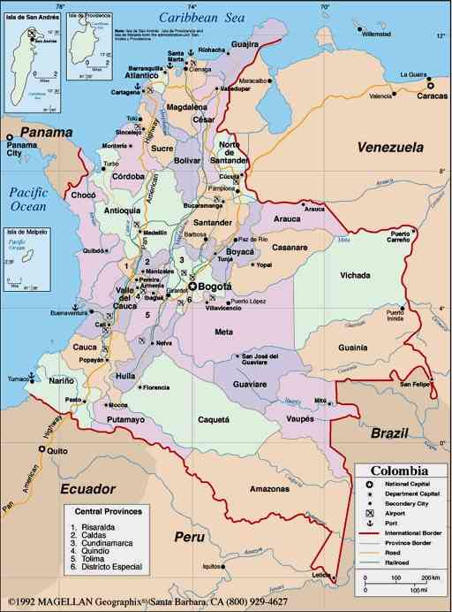
Colombia at a Glance
3rd largest population in Latin America (48 million)
Location
Literacy Rate: 94%
5 cities with 1 million+ consumer bases
Fastest growing market in Latin America for oil and gas production

Slide 5
Colombia at a Glance: Demographics
Middle class is a growth indicator for buying power and opportunity for innovation. Percentage of people in 20-40 age group:
20-29 17%
20-34 24%
20-39 31%
The middle class represents 35.3% of the total Colombian population

Slide 6
Presidents Obama and Santos announcing the US-Colombia FTA- April 2012

Slide 7
Market Trends: Colombia’s FTA Negotiations
Agreements implemented:
Andean Community (CAN) (Ecuador, Peru, Bolivia)
Mercosur (Argentina, Brazil, Paraguay, Uruguay)
Mexico
Chile
Canada
USA
Ratified:
Central America Triangle (Honduras, El Salvador
and Guatemala)
European Free Trade Association EFTA (Switzerland, Norway, Iceland and Liechtenstein)
Pending implementation:
European Union

Slide 8
Market Trends: U.S.-Colombia FTA
Will help NEI but is NOT a cure-all
It can: - Increase exports to Colombia by $1.1 billion
- Create/save jobs
- - Increase market access for goods and Colombia’s $166 billion services market
- - Non-tariff barriers to trade will be progressively eliminated as FTA enters into force
- Improve business climate by reducing corruption and informality

Slide 9
Market Trends: U.S.-Colombia FTA
90% of Colombian products enter the U.S. market duty-free, while U.S. merchandise entering Colombia face tariffs averaging nearly 9%.
FTA will eliminate tariffs for over 80% of U.S. exports of consumer and industrial products (excluding petroleum) immediately upon implementation and 87% within 5 yrs.
The impact of eliminating tariffs and related barriers in Colombia is estimated to increase U.S. GDP by nearly $2.5 billion.
Largely complementary economy (grains vs. tropical fruits; textiles vs. apparel)

Slide 10
Market Trends: U.S. Colombia FTA
Currently U.S. auto parts face a 17.4% tariff, building products face a 13.2% tariff and consumers goods face a 15% tariff.
Non-tariff barriers to trade are progressively eliminated as FTA enters into force.
99% of qualifying industrial and textile goods will become duty free.
Most remaining tariffs will be phased out 15 years.
89% of Agricultural goods will become duty free.
Largely complementary economies (grains vs. tropical fruits; textiles vs. apparel).

Slide 11
Market Trends: U.S.-Colombia FTA
76% of sales from US to Colombia consists of:
Machines and mechanical equipment
Organic Chemicals
Transport Equipment
Minerals & Fuels
Plastics and machinery
Electrical machinery
Agro industrial

Slide 12
Market Trends: U.S.-Colombia FTA
Liberalization of products in key sectors such as:
Construction Equipment/Building Products
Aircrafts and parts
Fertilizers
Agrochemicals
Wood
IT
Medical and scientific equipment
Improved access to financial services

Slide 13
Market Practices Tips for Success in Colombia
www.export.gov
http://usbusiness-opportunities-embassybogota.com/
USDOC FTA tool: An easy to use tool to find out what tariffs are: http://export.gov/fta/ftatarifftool

Slide 14
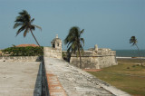
Cameron Werker
Commercial Counselor
Cameron.werker@trade.gov
Nicole DeSilvis
Commercial Attaché
Nicole.desilvis@trade.gov
US Commercial Service – Unit 3030
Box 5120, DPO, AA 34004
Tel: (571) 383-2519
Fax: (571) 315-2171
www.buyusa.gov/colombia

Slide 15
BRT & Traffic Management Center Projects in Colombia 2012

Slide 16
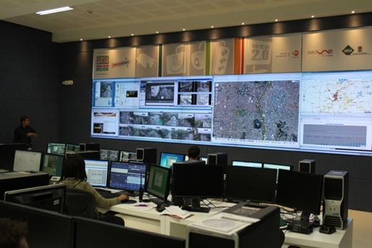
Agenda
ISA & XM
ITS Government Programs DNP – National Planning
Medellin Traffic Management Center

Slide 17
ISA and its business
ISA executes important projects in linear infrastructure systems that enhance continental development.
Its activities are focused on the businesses of Electric Energy Transport, Telecommunications Transport, Road Concessions, Smart Management of Real Time Systems and Construction of Infrastructure Projects.
Electric Energy Transmission
ISA expands, operates and maintains high-voltage energy transmission systems - Colombia, Peru, Bolivia, Brazil, and is currently constructing the Electric Interconnection System for Central America
Thanks to the 38,989 km of high-voltage circuit operated by the ISA Group, ISA is recognized today as one of the largest international transporters of energy in Latin America.
ISA, through it´s subsidiary XM, operates the Colombian National Interconnected System
Telecommunications Transport
As carrier of carriers, has access to a 12,029-km fiber optics network integrating Colombia, Ecuador, Peru, Chile and Venezuela, and entering Argentina and Brazil.
Road Concessions
ISA currently has 907 km of highways in Chile.

Slide 18
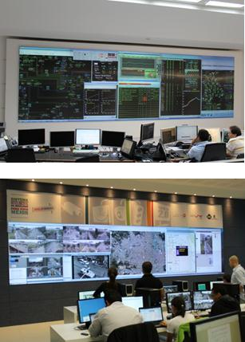
Smart Management of Real-Time Systems
XM is a subsidiary of ISA , dedicated to the Smart Management of Real-Time Systems, which is the planning, designing, optimizing, contracting, operating, administrating and managing transaction systems and technological platforms that involve value-added information exchange, as well as related markets of goods and services
Currently operates in 3 areas:
Electricity Sector: XM operates Colombian National Interconnected System and manages the Energy Market in Colombia.
Financial Sector: participates in the company that manages the derivatives markets energy commodities in Colombia and participates as an investor in the House of Central Counterparty Risk.
Traffic and Transport Sector: XM operates the Mobility Management in Medellin, a city with nearly 3 million inhabitants.

Slide 19
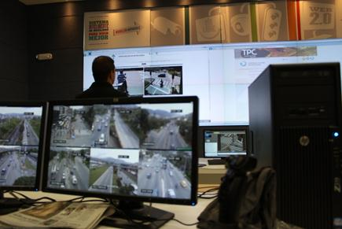
How do we approach it?
Planning:
LT, MT, ST
Programming
Supervision & Coordination
Information Management
Technological Management
Enabling Management Processes:
financial, legal and regulatory, risk, human resources

Slide 20
XM General Smart Mobility Model
Long Term Planning
Social & environmental management
Mid Term Planning &
Coordination
Technological surveillance
Short Term Planning &
Coordination
Coordination
with Gobernment
& Public
entities
Analysis of the Legal, Regulatory, and Policy Environment
Control
Center
Real time
Supervision
Photo detection, CCTV
Coordination with authorities
Information Management
User information
Coordination with urban planning
Emergency & crisis mgmt
Radio
Risk analysis
web
DMS
Parking
Call center
Education, mobility and citizenship
Maintenance and asset management
Interurban mobility planning

Slide 21
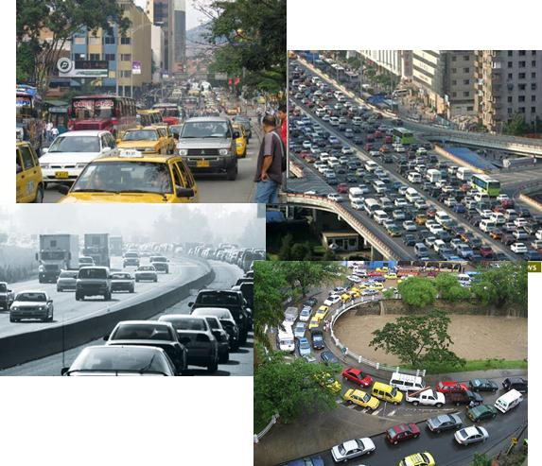
Government Programs
Quality of life
Productivity
Competitiveness
Urban Transport
Urban development
Tenement / housing
Water and sanitation
Improving the mobility of cities

Slide 22
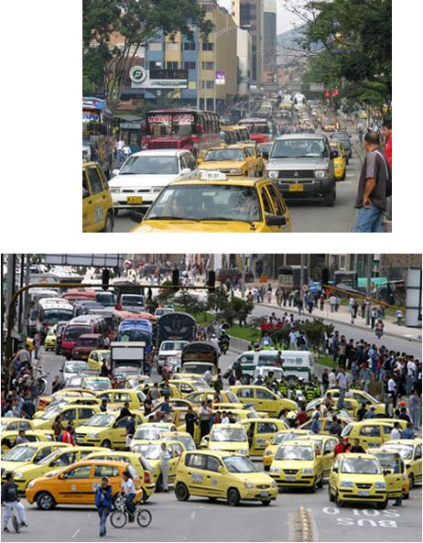
Current Situation and Challenges
In general terms…
Changes in government approaches
Little political support for initiatives
Lack of resources
Fear of making unpopular decisions
In specific terms…
Little long and medium term planning
Weak institutional coordination
Delay in information systems
Little linking of users to services
Weaknesses in enforcement/compliance
Source: Gobernabilidad Corporativa en Empresas Públicas del Sector Transporte. Banco Mundial. Departamento de Desarrollo Sostenible. Región de Latinoamérica y el Caribe. 2008

Slide 23
Government Plans
Source : Luis Felipe Lota. Programa Nacional de Transporte Urbano. 2012

Slide 24
Government Plans
Public Transportation Systems
- BRT
Mobility Management
Systems
Source : Luis Felipe Lota. Programa Nacional de Transporte Urbano. 2012

Slide 25
Medellín Traffic Management Center

Slide 26
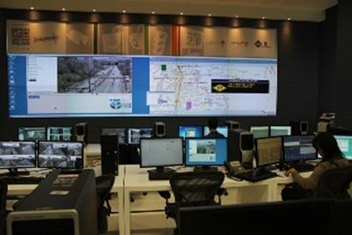
Transit and Transportation Sector
The Traffic Management Center is a modern and innovative facility that positions Medellín at the forefront of the world in terms of the use of intelligent transportation systems.
The coordination and operation of the SIMM is done through the "Traffic Management Center". The only control center of its kind in Colombia.
XM possesses experience with the planning, design, implementation and operation of control centers, as well as the intelligent management of real-time information systems.
XM is recognized for its ability to develop real-time intelligent systems, designing and implementing in record time the physical and technological infrastructure for the operation of advanced control centers using best practices.

Slide 27
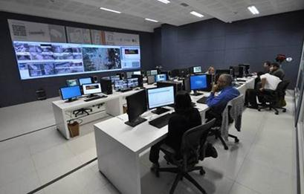
Medellin Traffic Management Center
Main objectives
Reduce road accidents
Reduce emissions
Reduce travel time and bottlenecks
Specific objectives
Maximize the utility of roads
Increase enforcement of traffic rules and transportation.
Reduce travel time and bottlenecks
Reduce vehicle emissions.
Improve the performance of public transport.
Improve the cost per minute displacement.
Reduce accidents.
Increase competitiveness and security.
Improve efficiency in the imposition of fines.
Monitoring and analysis of real-time traffic flow
Dissemination of traffic information in real time to shift decision-making.
Provision of timely information to citizens on the state of the roads.
Collection of information for studies of traffic flow.
Improved service quality of public transport.

Slide 28
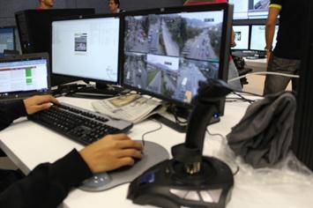
Medellin Traffic Management Center General Components
Police Agents Coordination & Fleet Control - AVL
Call center
Photo enforcement
Traffic Management Center
Traffic signal planning & coordination
CCTV
Information Management
Dynamic signal messaging

Slide 29
Medellin Traffic Management Center
Detailed Components
Traffic signal network
Modernization of the traffic signal network
Obra Civil
Photo enforcement system
Fixed and mobile cameras to control offenses
CCTV System
Cameras to monitor road conditions
Dynamic message signs
Message sign panels at entrances and major corridors
Bus fleet management
TPC control systems through GPS / RFID fixed readers
Taxi fleet management
Control system through identification tags and RF readers
Central management software
Software interfaces for integration with other modules
Civil Works
New facilities that integrate the operation of all systems
Signaling
Signage on main road corridors
Radio Station
Radio stations to report on traffic/transit issues
Call Center
Telephone transit information center

Slide 30
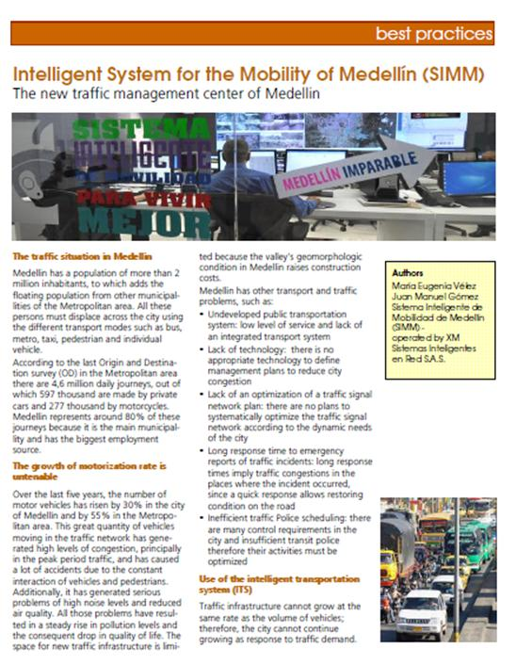
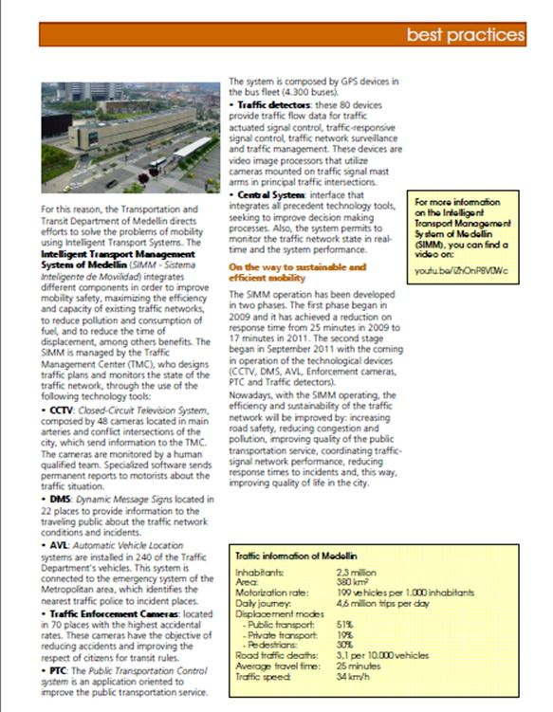
Cities for Mobility Publication
http://issuu.com/citiesformobility/docs/cfm_emagazine__2012_1?mode=window&viewMode=doublePage

Slide 32
USTDA Support for ITS and Public Transportation in Colombia American Public Transportation Association
Jacob Flewelling
Country Manager, Colombia
July 19, 2012

Slide 33
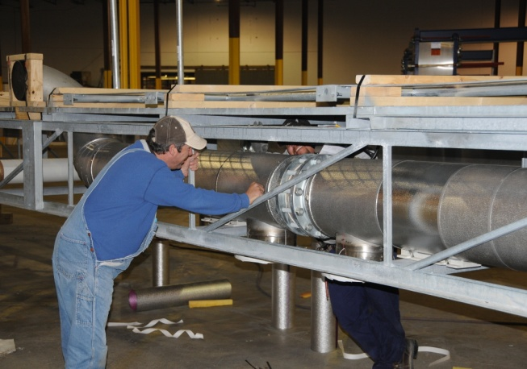
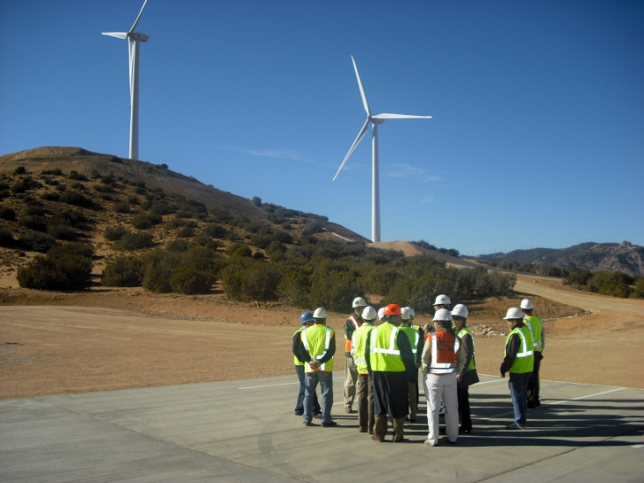
Mission Statement
USTDA helps companies create U.S. jobs through the export of U.S. goods and services for priority development projects in emerging economies
USTDA links U.S. businesses to export opportunities by funding project planning activities, pilot projects, and reverse trade missions while creating sustainable infrastructure and economic growth in partner countries
Notes:
The U.S. Trade and Development Agency’s mission is based on two central principles:
Supporting sustainable infrastructure and economic growth in partner countries
Helping companies create U.S. jobs through the export of U.S. goods and services for priority development projects in emerging economies

Slide 34
USTDA Highlights
Independent agency of the U.S. Government, established in 1981.
USTDA invested over $44 million in grants and contracts in FY 2011.
USTDA has facilitated over $40 billion in U.S. exports to emerging markets.
Key number:
$1 to $58 (export multiplier)
www.ustda.gov

Slide 35
USTDA Program Activities
Matching U.S. Commercial Interests
with Development Opportunities
International Business Partnership Program
Reverse Trade Missions
Conferences
Workshops
Project Development Program
Feasibility Studies
Pilot Projects
Technical Assistance

Slide 36
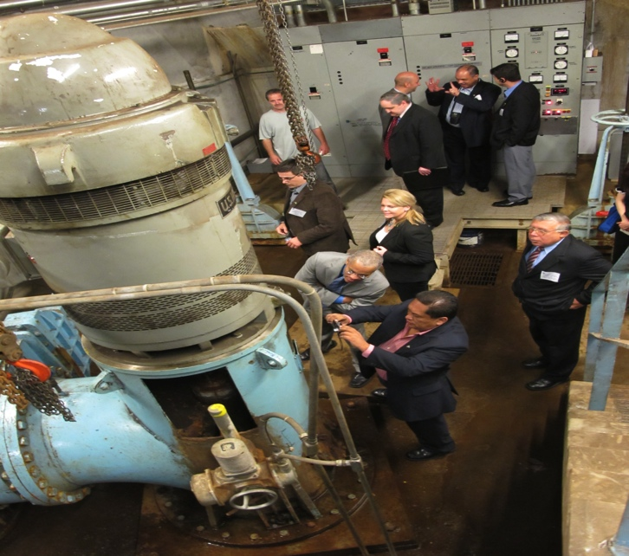
International Business Partnership Program
Reverse Trade Missions:
USTDA brings foreign project sponsors to the United States pending upcoming procurements to observe the design, manufacture, and operation of U.S. products and services.

Slide 37
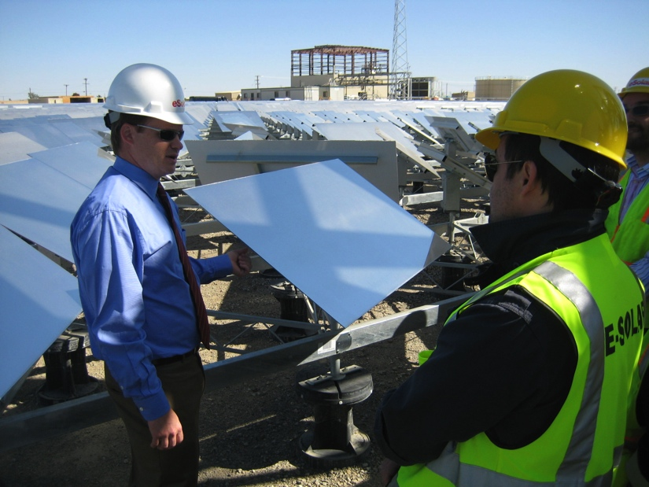
Project Development Program
Feasibility Studies:
USTDA-funded and U.S.-led feasibility studies link foreign project sponsors with U.S. businesses at the critical early stage of project development. Analysis includes:
Technical
Financial
Legal
Environmental
Lifecycle costing

Slide 38
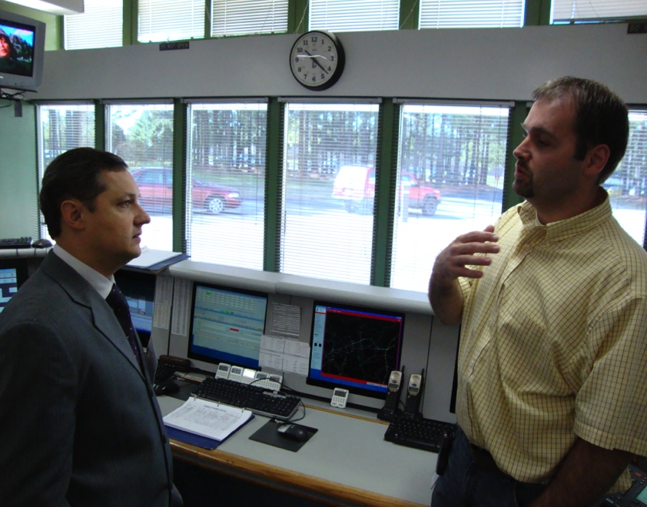
Project Development Program
Pilot Projects:
USTDA-funded technical assistance for pilot projects demonstrate the effectiveness of commercially proven U.S. technologies and equipment in the foreign buyer’s setting.

Slide 39
USTDA By Sector (As a Percentage of USTDA’s FY 2011 Program Budget)
Notes:
Clean Energy and Transportation are typically large sectors for the agency’s activity. During fiscal year 2011, they accounted for well over half of USTDA’s work. Other key sectors include telecommunications, water and the environment, and services.

Slide 40
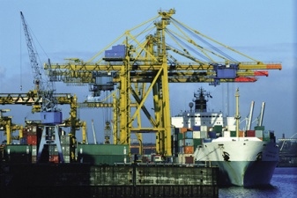
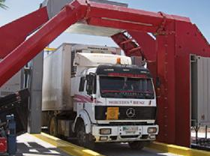
USTDA Activities in Colombia - Examples
Non-Intrusive Cargo Inspection Systems for the DIAN (US$637,000)
Master Plan Update for El Dorado International Airport in Bogota (US$891,840)
Magdalena River Port - Terminal Fluvial Andalucia (US$550,000)
Port of Cartagena Container Security Initiative feasibility study (US$399,962)

Slide 41
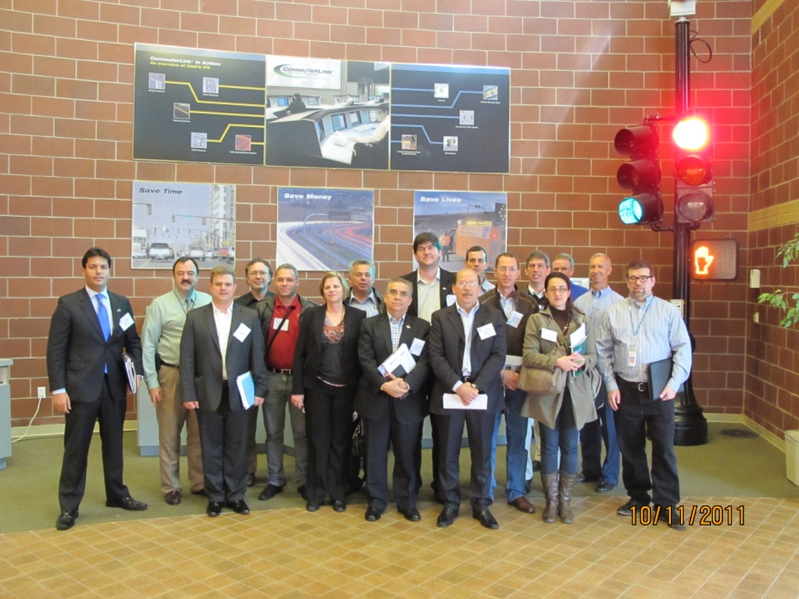
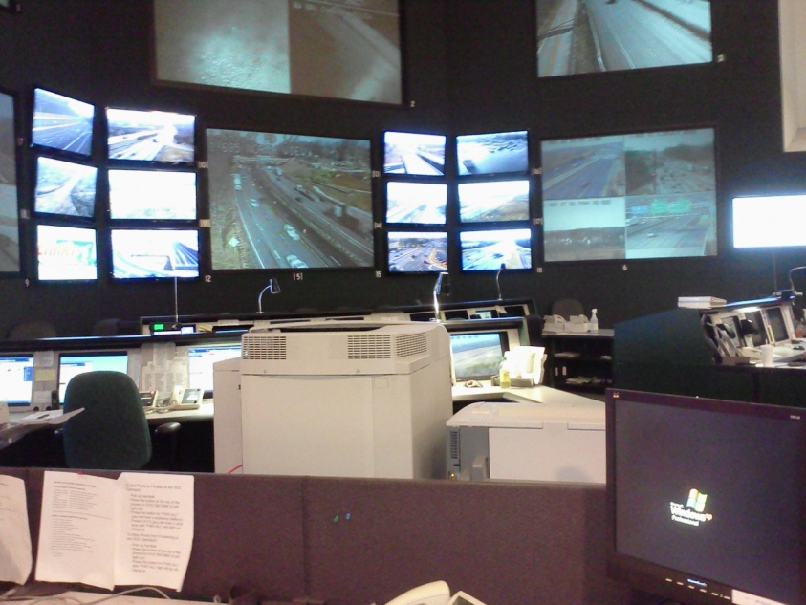
ITS Activities in the LAC Region
Series of Three ITS Technical Visits (RTMs):
Brazil, Colombia and Mexico, Oct 2011 – March 2012
Brazil – EcoRodovias ITS Modernization & Expansion TA (US$460,000)
Mexico: SCT National ITS Architecture Technical Assistance ($431,000)
Brazil: Belo Horizonte Intelligent Transportation System Feasibility Study ($294,000)
Chile: National ITS Architecture Feasibility Study ($379,644)

Slide 42
Colombian Public Transit Market
Top Prospects for U.S. Companies:
CCTV for ITS applications (plate recognition, traffic analysis, photo enforcement)
Signaling
RFID (toll road, vehicular identification)
Electronic fare collection systems
Vehicle maintenance sensors
Passenger counters
Fuel control sensors
Biometric and face recognition systems
Access control systems
Fleet management systems

Slide 43
Colombian Public Transit Market
Key Buyers:
Mid to Large Cities
Transportation companies, municipal governments, Secretaries of Transportation and Transit
Elements of Potential Market Entry Strategy:
Form partnerships, consortiums, or temporary alliances with in-country technology integrators and distributors to:
Gain knowledge of the local market
Enhance competitiveness of bids
Attend conferences and events hosted by trade associations
ANDI – Third Congress on Passenger Transport: Sept 12-13, Bogotá
(http://www.andi.com.co/pages/proyectos_paginas/proyectos_detail.aspx?pro_id=344&Id=66&clase=8&Tipo=2)
ADITT (Asociación para el Desarrollo Integral del Transporte Terrestre Intermunicipal – www.aditt.org)

Slide 44
Market Research – Local Companies
Sytecsa is an experienced technology integrator interested in representing companies and products that broaden its portfolio and market coverage. Sytecsa seeks to build synergies that allow it to take full advantage of market opportunities.
Delegate on USTDA’s Colombia ITS Reverse Trade Mission:
Jaime Zárate
Vice President, Planning & ITS Systems & Technologies S.A. - SYTECSA Email: j.zarate@sytecsa.com
Tel: +57 4 448 0370 Ext 115
Cell: +57 314 794 1593 Calle 18 Sur # 26 - 42 Medellin - Antioquia

Slide 45
Using USTDA’s Resources
Visit our website at www.USTDA.gov
Monitor current business opportunities with USTDA and our overseas grant recipients.
Sign up for our e-newsletter to learn about our upcoming events.
Sign up for procurement announcements on FedBizOpps (www.fbo.gov)
Obtain the public version of the final report of USTDA-funded studies.
www.ustda.gov
Notes:
I encourage you to visit our website to check current business opportunities around the globe and upcoming events here in the U.S. On our website you can also see examples of past projects and sign up for automatic updates.

Slide 46
USTDA Funding Criteria
USTDA evaluates projects based on
the following criteria:
Likelihood of success receiving implementation financing
Mutual benefits for the United States and partner country, including commercial opportunities for U.S. firms
Developmental priority in the host country
Notes:
In order for USTDA to consider a project for funding, it needs to be a strong match with our funding criteria.
USTDA evaluates projects for funding support based on the following elements:
1) Whether the project is a developmental priority for the project sponsor and host country;
2) The likelihood that the project will receive implementation financing; and
3) Whether the project offers mutual economic benefits for the United States and the host country, including opportunities for commercial cooperation with U.S. firms.

Slide 47
Presenting Projects for USTDA Consideration
Contact Jacob Flewelling, Country Manager for Colombia
Based on initial feedback, send a concept paper to USTDA.
There is no formal application, nor a recurring due date for the submission of proposals.
Guidelines on what USTDA looks for in an eventual full proposal can be found at: http://www.ustda.gov/program/ModelProposalFormat USFirms2010.pdf
Notes:
There is no formal application or deadline to apply for USTDA assistance for feasibility study or technical assistance funding. Guidelines can be found on USTDA’s website at www.ustda.gov under Model Proposal Format.
Requests can be made year-round and can come from a foreign entity or project sponsor, or from a U.S. firm interested in a particular project.
I would like to reiterate that both public and private overseas entities are eligible to receive USTDA assistance.

Slide 48
Contact USTDA
Telephone (703) 875-4357
Fax (703) 875-4009
Website: www.ustda.gov
Nathan Younge , Regional Director, Latin America and the Caribbean
nyounge@ustda.gov
Jacob Flewelling, Country Manager, Andean Region and Caribbean Basin
jflewelling@ustda.gov
Isabel Sepulveda, Project Analyst Contractor
isepulveda@ustda.gov
Eric Toler, Project Analyst Contractor
etoler@ustda.gov
www.ustda.gov

Slide 49
Thank You!
We hope you had a great trip to Colombia!
Contact Information:
Julia Walker
Program Manager – International Programs
American Public Transportation Association
Tel: +1 202-496-4833
E-mail: jwalker@apta.com

